Slide 1
Methods I Lab
Lecture 4

Slide 2
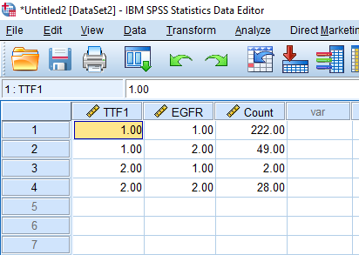
2x2 Table in SPSS - Exercise
Create a 2x2 table from weighted data
Open a new data window
  File -> New -> Data
Enter lung cancer and EGFR mutation example into SPSS
TTF-1 | EGFR Status | Count
1 | 1 | 222
1 | 2 | 49
2 | 1 | 2
2 | 2 | 28

Slide 3
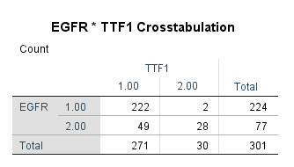
2x2 Tables in SPSS - Exercise
First, we must select which of the 3 variables in SPSS contains the counts
Data
  Weight Cases
    Select ‘Weight Cases By’
      Select count variable
Second, we can Compute the 2x2 table
Analyze
  Descriptive Statistics
  Crosstabs
    Select EGFR as the ‘Row(s)’ & Select TTF1 as the ‘Column(s)’
    Okay

Slide 4
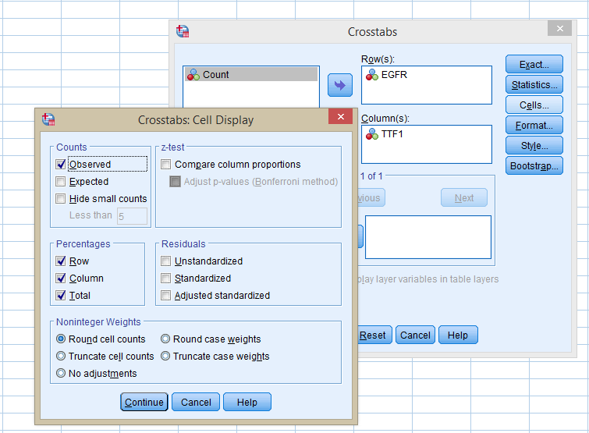
Analysis in SPSS - Exercise
Produce crosstabs with TTF1 as the column variable and EGFR status on the row
Analyze
  Descriptive Statistics
    Crosstabs…
      Row(s) : Positive Test
      Column(s): Positive Disease
    Cells…
      Row, Column, and Total Percentages

Slide 5
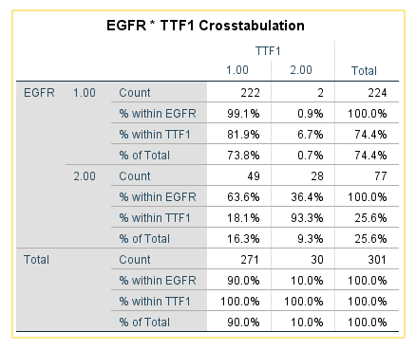

Analysis in SPSS - Exercise
Assume that TTF-1 positive status (indicated by a value of 2) indicated being disease positive. Further, assume that having an EGFR mutation (indicated by a value of 2) can be a test for the disease.
Consider what the PPV and NPV is and identify the corresponding %

Slide 6
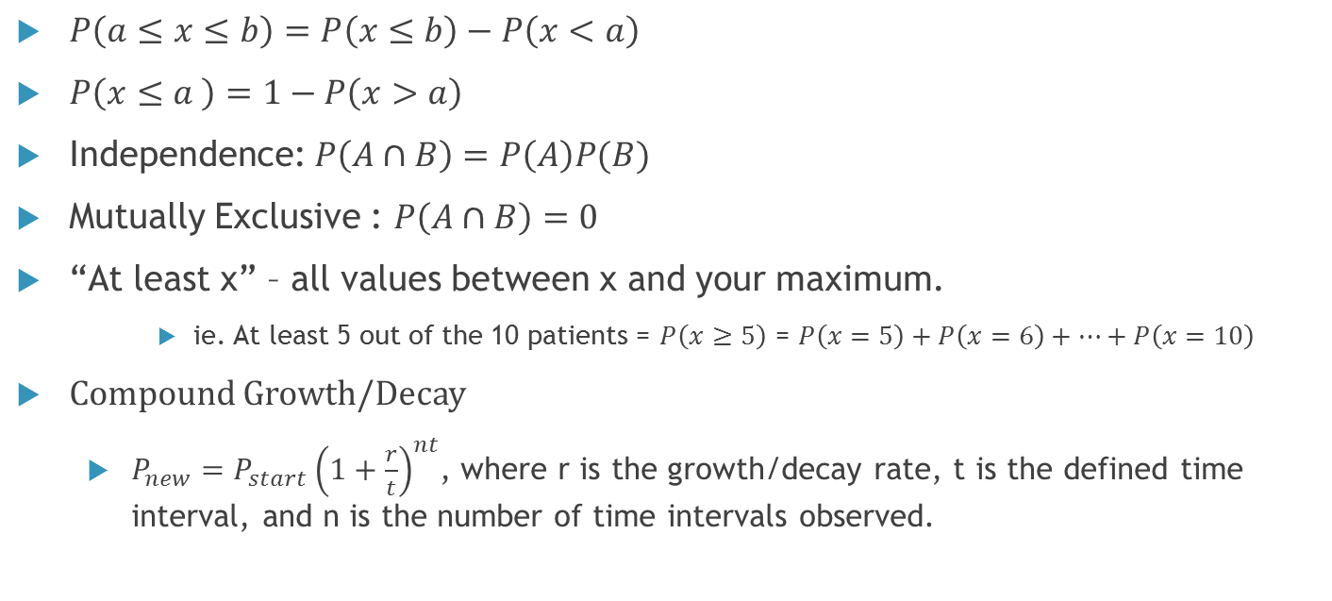
Notes on Probabilities
$P\left(a≤x≤b\right)=P\left(x≤b\right)−P\left(x<a\right)$
$P\left(x≤a \right)=1−P\left(x>a\right)$
Independence: $P\left(A∩B\right)=P\left(A\right)P(B)$
Mutually Exclusive : $P\left(A∩B\right)=0$
“At least x” – all values between x and your maximum.
    ie. At least 5 out of the 10 patients = $P\left(x≥5\right)$ = $P\left(x=5\right)+P\left(x=6\right)+…+P\left(x=10\right)$
Compound Growth/Decay
  $P_{new}=P_{start}{\left(1+\frac{r}{t}\right)}^{nt}$, where r is the growth/decay rate, t is the defined time interval, and n is the number of time intervals observed.

Slide 7
Probabilities from Discrete and Continuous Distributions in SPSS
There are probability tables for continuous and discrete distribution in the back of the textbook.
  Finding probabilities could be done by using the tables
In SPSS, probabilities from distributions are calculated using the
  Probability density function (PDF for continuous distributions)/Probability mass function (PMF for discrete distributions) P(X=x)
  Cumulative distribution function (CDF)

Slide 8
Probabilities from Discrete and Continuous Distributions in SPSS
In order to find the PDF/PMF and CDF in SPSS, you must specify the quantity (which is the x values) and the parameters for each distribution
Parameters describe the distribution
  For example, Binomial Distribution parameters are n and p (sample size and probability)
PDF and CDF notation in SPSS
  PDF.BINOM(quant,n,prob) and CDF.BINOM(quant,n,prob)
  PDF.POISSON(quant,mean) and CDF.POISSON(quant,mean)
  PDF.UNIFORM(quant,min,max) and CDF.UNIFORM(quant,min,max)
  PDF.NORMAL(quant,mean,stddev) and CDF.NORMAL(quant,mean,stddev)

Slide 9
Binomial Distribution - Exercise
Consider 8 patients on a treatment where the probability of treatment success is .25.
  Find the probability that 7 out of 8 patients will have successful treatment?
  What is the probability that more than 5 patients have successful treatment?
  What is the probability that between 3 and 7 patients have successful treatment?

Slide 10
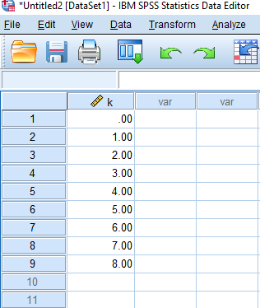
Binomial Distribution - Exercise
First, we will enter all possible numbers for k into SPSS
Second, we must use transform to find the probability
mass function (PMF)
Transform
  Compute Variable
    Type in new Target Variable name as PMF
    Select PDF & Noncentral PDF
    Select PDF.Binom
      PDF.BINOM(k,8,0.70)
        Select Ok
Go into Variable View
  Change Decimal Places to 4 for new PMF variable -> Go back to Data View

Slide 11
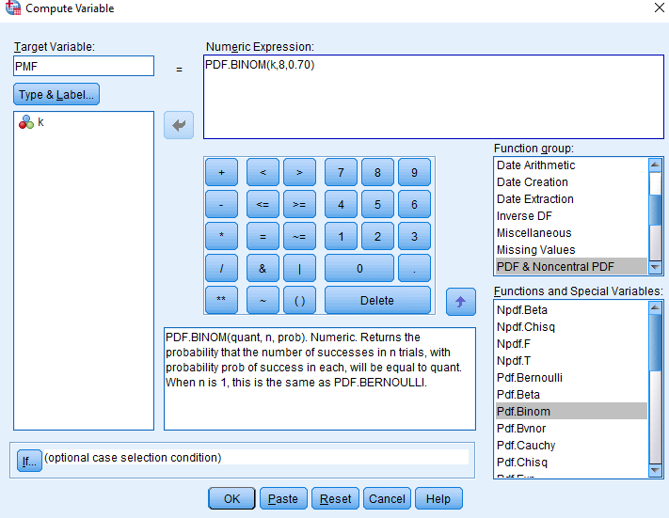
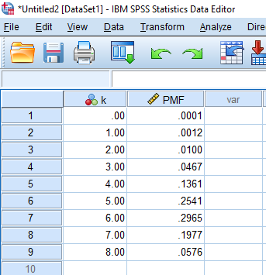
Binomial Distribution - Exercise
  Find the probability that 7 out of 8 patients will have successful treatment

Slide 12
Binomial Distribution - Exercise
Third, we must use transform to find the cumulative density
Transform
  Compute Variable
    Type in new Target Variable name as CDF
    Select CDF & Noncentral CDF
    Select CDF.Binom
      CDF.BINOM(k,8,0.70)
        Select Ok
Go into Variable View
  Change Decimal Places to 4 for new CDF variable -> Go back to Data View

Slide 13
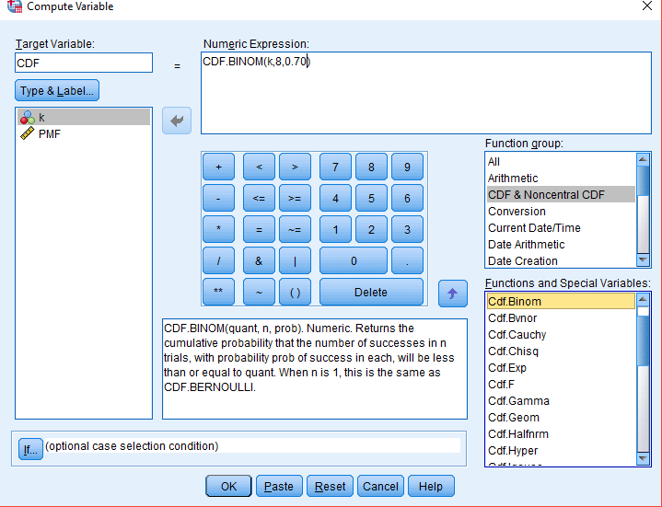
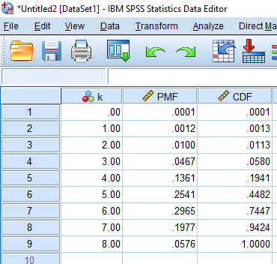
Binomial Distribution - Exercise
P(X>5) = 1 - P(X≤5) = 1-0.4482 = 0.5518

Slide 14
Binomial Distribution - Exercise
P(3≤X≤7) = P(X≤7) - P(X<3) = P(X≤7) - P(X≤2) = .9424 - .0113 = .931

Slide 15
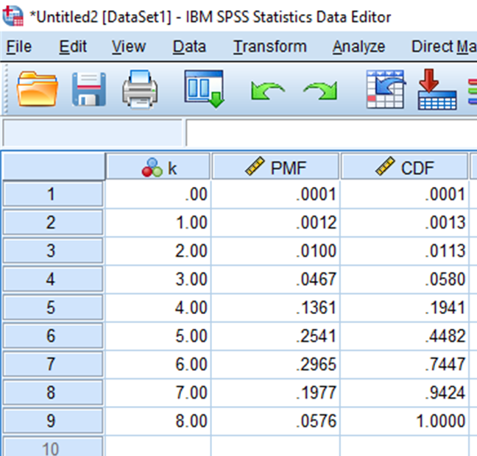
Binomial Distribution - Exercise
Alternatively, you could also find P(3≤X≤7) using the PMF
P(3≤X≤7) = P(X=3) + P(X=4) + P(X=5) + P(X=6) + P(X=7)
= .0467 + .1361 + .2541+ .2965 + .1977
= .931

Slide 16
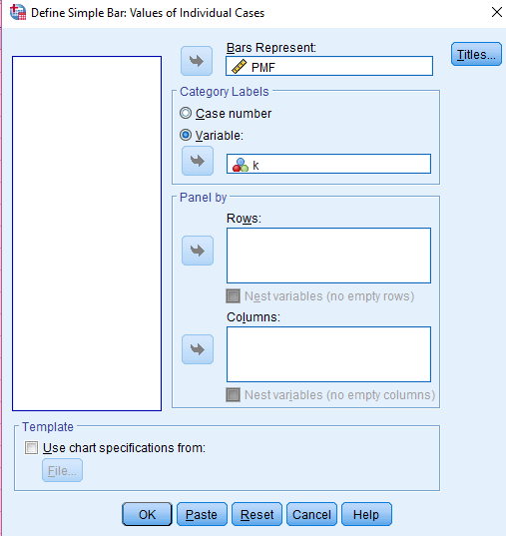
Binomial Distribution - Exercise
Now, we want to Compute a graphical display of the PMF
Graphs
  Legacy Dialog
    Bar
      Select Simple Bar Graph and Select “Values of Individual Cases”
        Select Define
          “Bar Represents” PMF variable
            “Category Labels” Select Variable and put k variable there
              Ok

Slide 17
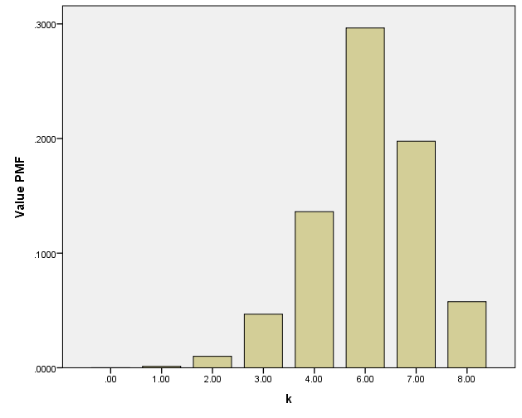
Binomial Distribution - Exercise

Slide 18
Notes: Probabilities is SPSS
The steps for finding probabilities for other discrete and continuous distributions are similar to the Binomial Distribution steps we just went through
You do not need to enter all values of x into SPSS to find probabilities, but you do need to enter all values of x into SPSS to compute a graphical display
For example, if you wanted to find P(X=7), you can enter 7 into SPSS and use the same steps as before to find this probability
  PDF.BINOM(k,8,0.70)

Slide 19
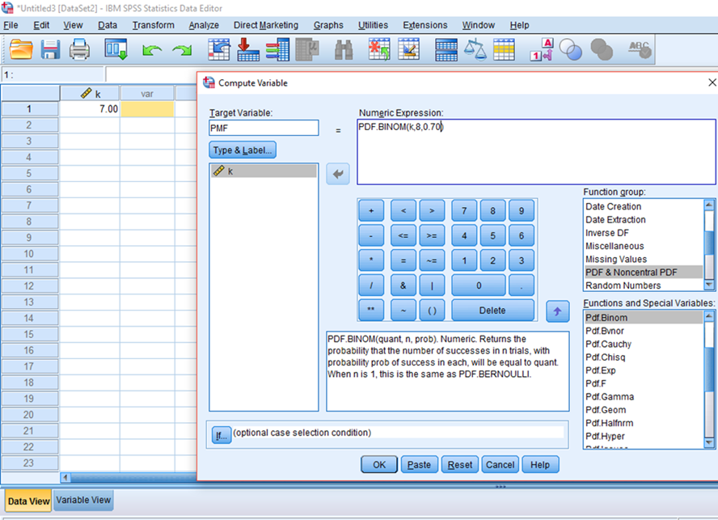
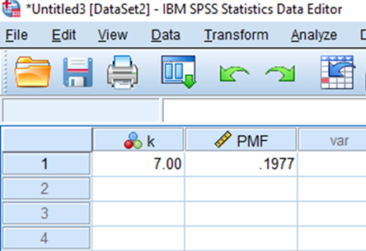
Notes: Probabilities is SPSS

